Slide 1
Electron Configuration

Slide 2
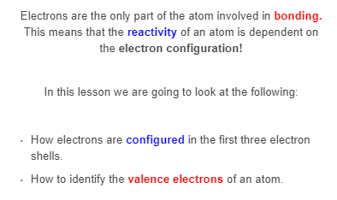

Slide 3
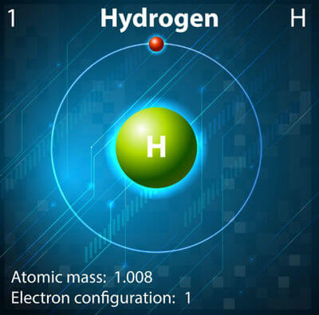
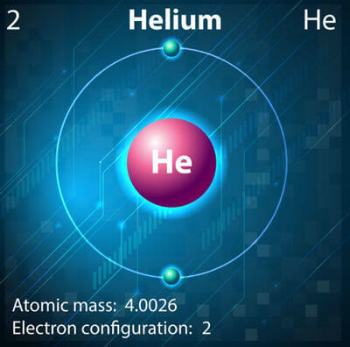
The first electron shell is very close to the nucleus, and can only hold 2 electrons.

Slide 4
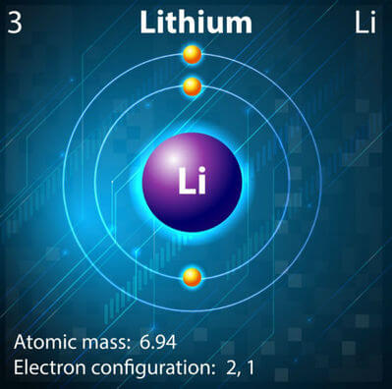
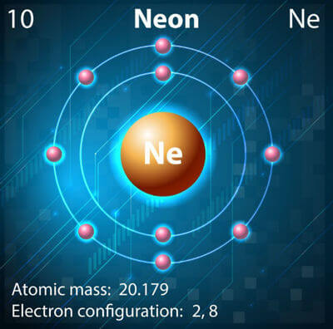
The second electron shell is further from the nucleus, and can hold 8 electrons.
Electrons are attracted to protons, and will always fill the electron shells closest to the nucleus first.

Slide 5
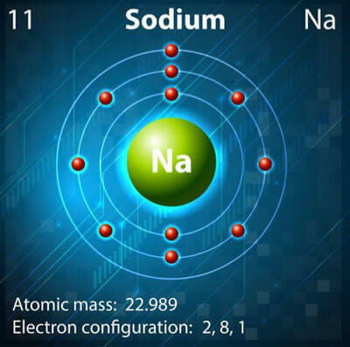
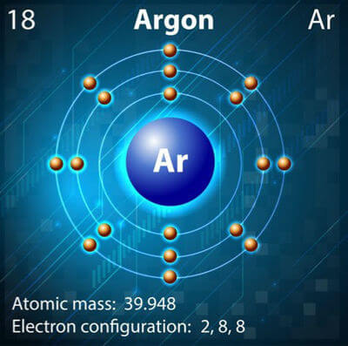
The third electron shell can also hold 8 electrons.
Technically the third electron shell can hold 18 electrons, but fortunately you won't need to deal with that just yet!

Slide 6
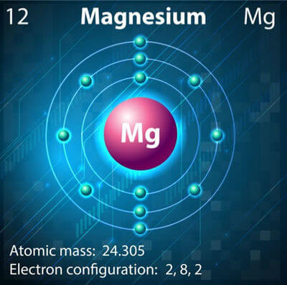
Electron configurations are used to show how the electrons are arranged in an atom.
For example, magnesium has the electron configuration 2,8,2. This is because there are 2 electrons in the first shell, 8 in the second and 2 in the third.

Slide 7

Watch this video (3:19) for another explanation of electron configurations.

Slide 8

You may have noticed in earlier lessons that it's not all the electrons that are involved in bonding:
Only the outermost electrons are involved in bonding.
These are known as valence electrons.

Slide 9
